Slide 1

Social Communication in Adults with Cognitive Impairments
CDS 663
Winter 2021

Slide 2
Consider…
People with aphasia due to left CVA often communicate better than they talk whereas people with acquired brain injury including right CVA often talk better than they communicate…
(Holland, 1975)

Slide 3

Video Example: Topic to Topic Switching after TBI
https://www.youtube.com/watch?v=aZxGcwHbVrc&list=PLdbdV0gzjUZgaZXRpYqGf-y3Aj9inbZn7

Slide 4
What is Social Communication?
Social Interaction | Social Cognition | Pragmatics | Language Processing
Social reasoning Social tasks Conflict resolution Social problem-solving | Theory of Mind Emotional competence Joint attention Inference Presupposition | Verbal: Speech acts Prosody Discourse Nonverbal: Body language Gesture Facial expression Proxemics Gaze shifts | Comprehension Expression Morphology Semantics Syntax Phonological skills
Source: ASHA.org, Components of Social Communication

Slide 5
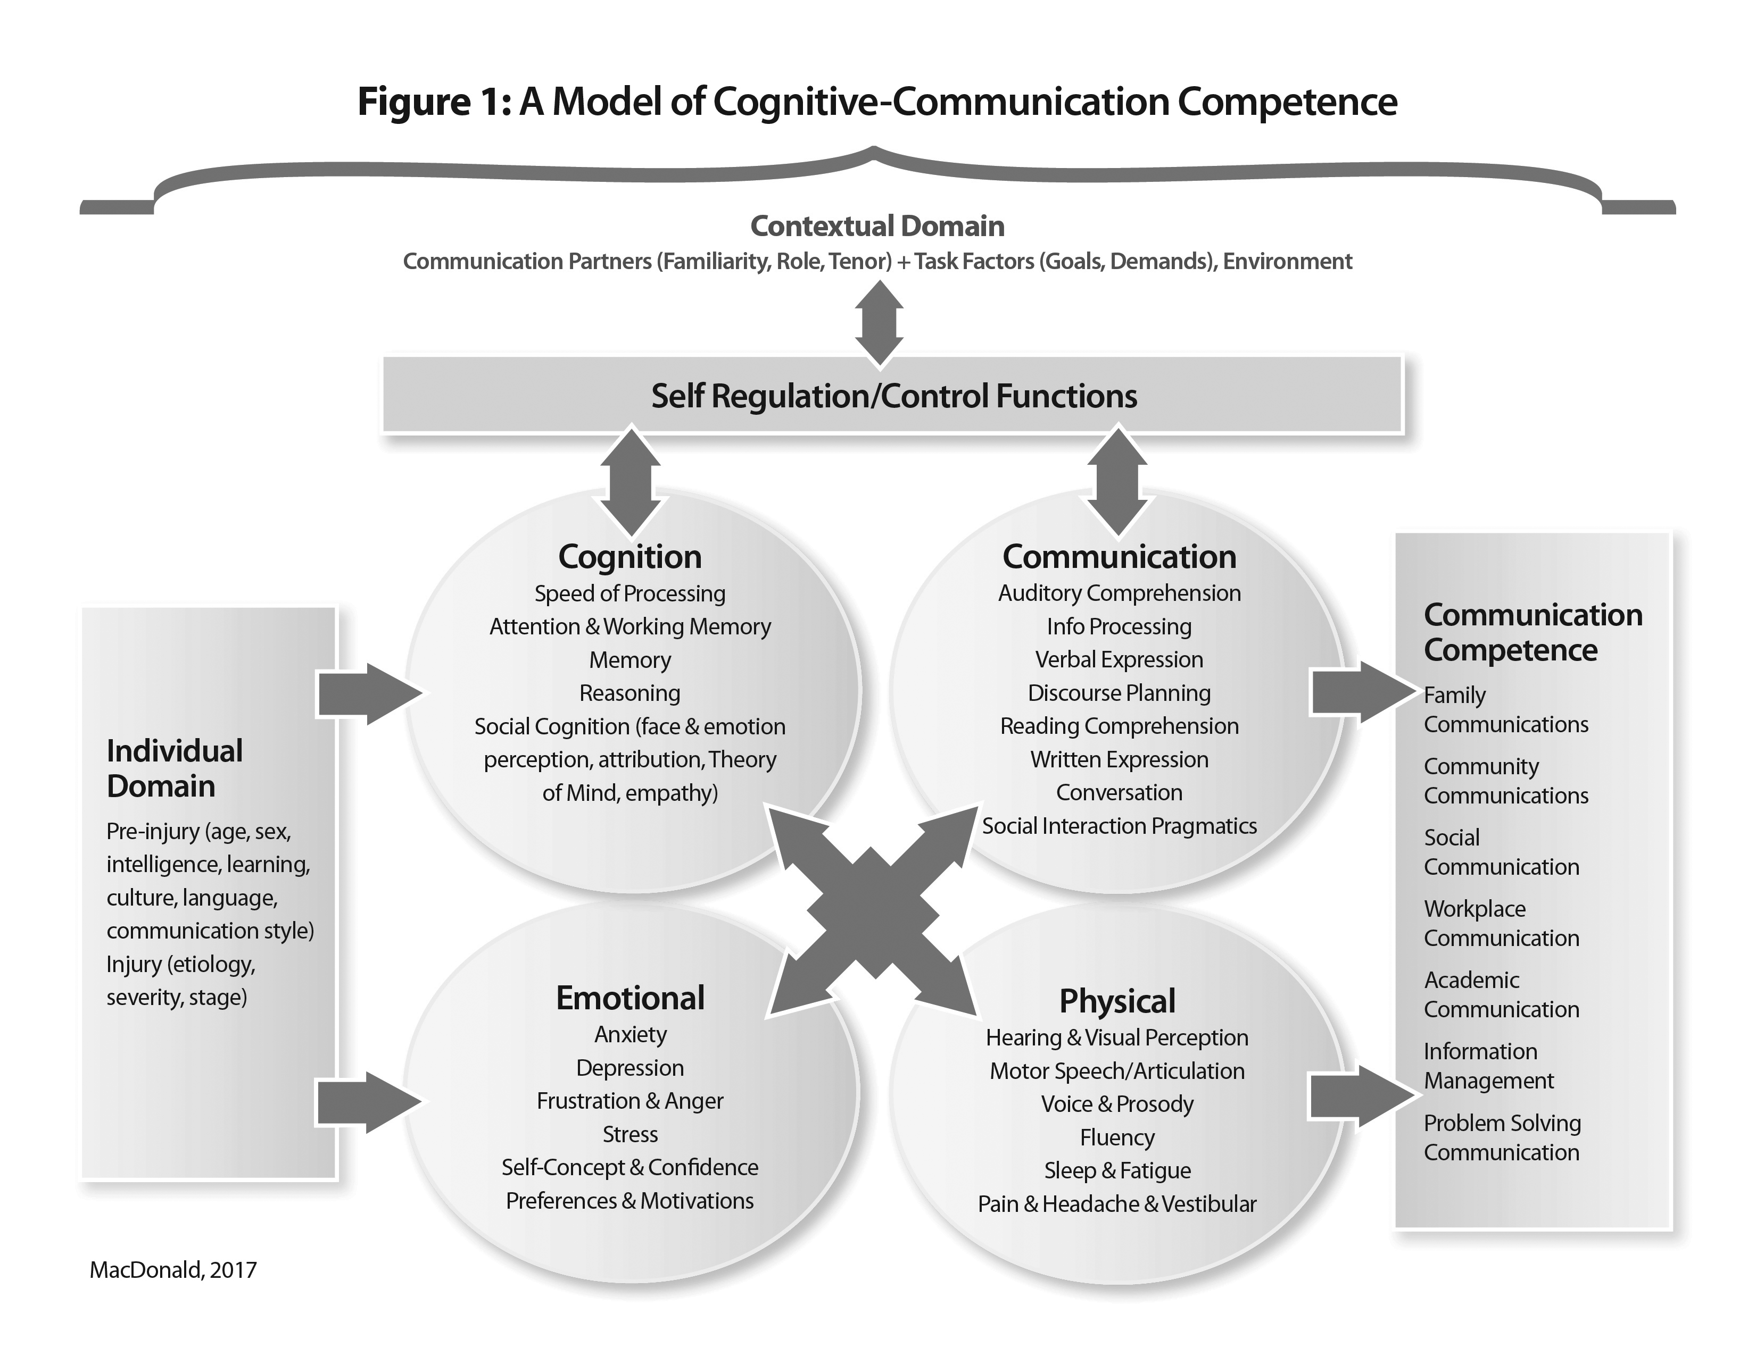
HOW DOES CULTURE PLAY A ROLE IN THIS MODEL?

Slide 6
Receptive Skills Commonly Affected by ABI
Emotion perception
Facial expression
Reading emotion in the voice
Reading emotion in body language
Social cognition, mentalizing, ToM
Picking up on social cues
Realizing your partner wants a speaking turn
Realizing your partner wants to leave the conversation

Slide 7
Expressive Communication
Spoken discourse
Less coherent and informative
More effortful or disorganized
Has social knowledge, difficulty applying it
Self-regulation
Self-awareness
Emotional expression
May have flat affect
May speak in monotone

Slide 8
Bond & Godfrey (1997); Coelho et al., (1995)
“The conversations of individuals with TBI have been characterized as significantly less interesting, less appropriate, less rewarding, more effortful, more confusing, more egocentric, and more reliant on conversation partners to maintain the flow of the conversation than their non-injured counterparts “

Slide 9
Common Profile: RH Social Communication Deficits
Difficulty w/inference (social cognition deficit)
Can’t read contextual cues—”I’m cold” doesn’t cue to open window
Lack of response/hyporesponsive
Flat, limited animation
Hyperresponsive
Digressions
Literal/Concrete in communication
Jokes/humor difficult; abstract language “heavy heart”

Slide 10
Social Communication Requires
Intact cognitive functioning
Intact speech and language
Intact psychological functioning
Environment that provides appropriate communicative opportunities

Slide 11
How may impairments in various cognitive domains affect communication?
Memory
Attention
Executive function
Initiation
Thought organization
Self-regulation
Impulsivity
Self-awareness

Slide 12
Cognitive prerequisites for competent social communication
Attention (Contingency)
Memory (e.g., topic maintenance)
Executive functions (Verbal organization)
Social cognition
Awareness (Effect of your behavior on others—appropriateness)

Slide 13
Social Cognition
Cognitive processes we use to encode and decode the social world
Processes we use to understand others
Theory of mind
Emotional recognition
Processes we use to understand ourselves
Social knowledge

Slide 14
TBI & Social Cognition
About 1/3 of people with brain injury have issues with social cognition
Difficulty with perception (labeling facial expressions, matching facial expressions, subjective report of changes in emotional experience)
Difficulty w/arousal & mimicry that may suggest problems with empathy

Slide 15
Theory of Mind
Ability to reason about the knowledge, beliefs, desires and intentions of others
Ability to understand the motivations behind behavior
Essential for interpersonal function such as social problem solving and negotiation

Slide 16
Examples
“No of course you don’t look fat”
Speaker Feeling
Lie: Speaker is sympathizing with the subject
Sarcasm: Speaker is ridiculing the subject
Speaker Belief
Lie: Speaker knows truth; listener does not
Sarcasm: Speaker knows truth and so does listener
“Yes, Johnnie has finished his dinner”
Speaker Feeling
Lie: Speaker is happy with the subject
Sarcasm: Speaker is ridiculing the subject
Speaker Belief
Lie: Speaker knows truth; listener does not
Sarcasm: Speaker knows truth and so does listener

Slide 17
Levels of TOM
Zero Order
Just requires knowing straight fact
First Order TOM
Requires person to think about another’s thoughts about an external event
Second Order TOM
Requires thinking about a second individual's thoughts about a third individual’s thoughts

Slide 18
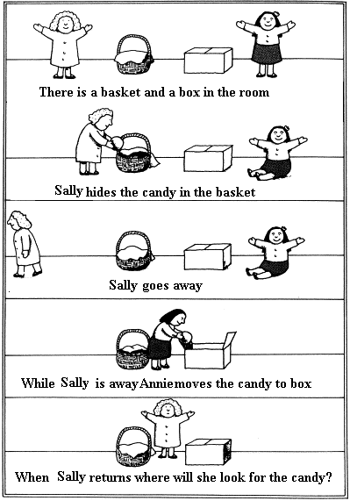
First order
False Belief
Task
(age 4 yrs)

Slide 19
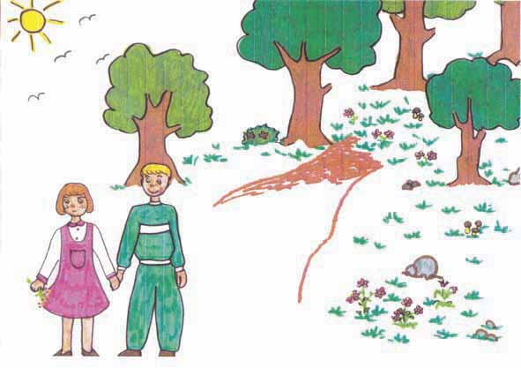
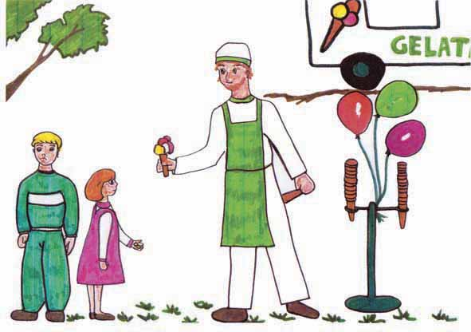
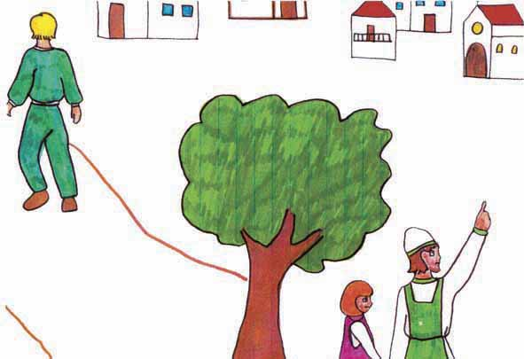
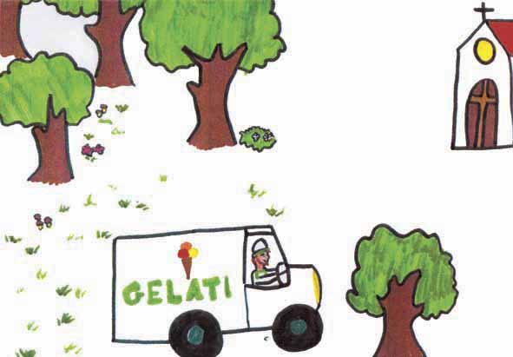
Second order False Belief task (age 6 yrs)
(The Ice-cream van, Wimmer & Perner, 1985).
John and Mary
go to the park.
Mary wants an ice-cream.
John forgot the money at home so he went to take it.
When John is gone,
the Ice-cream van moves
to the church.
FALSE BELIEF QUESTION:
What Mary thinks that John thinks ...

Slide 20
Other Typical TOM Tasks
Faux Pas--hear a story where someone commits a faux pas and have to recognize social transgression (Who? Why? What did they feel?)
Character Intention Test (Choose last cartoon slide by understanding mental state of protagonist)

Slide 21
Why do we care about TOM?
Disrupts social communication and may produce difficulty with:
Providing adequate information
Commenting on conversation
Organizing thoughts
Taking another’s perspective
Predicting outcomes and deciphering intentions

Slide 22
Signs of TOM Deficits
Clinical features
Does not intuit another’s perspective unless explicitly stated
Egocentric
Inappropriate levels of disclosure
Overly familiar
Cannot identify sources of interpersonal conflict

Slide 23
What causes TOM Deficits in TBI?
Working Memory & Executive Function
(Bibby & Mcdonald, 2005; Milder et al., 2006; Dennis et al., 2009)
It’s a specific unique ability unrelated to EF (Geraci et al., 2010; Muller et al., 2010)
IQ & TOM; IQ & TOM Intellectual and TOM are dissociated

Slide 24
Key Assessment Domains
Individual Factors
Contextual
Restricted network/opportunity
Unhelpful primary communication partner(s)
Cognitive
Communication/Language/Linguistic abilities
Emotional/Psychological
Personality variables-Assertiveness
Depression-lack of initiation
Anger-lack of social engagement
Physical/Sensory
Hearing
Vision
HOW DOES CULTURE PLAY A ROLE IN ASSESSMENT of SOCIAL COMMUNICATION?

Slide 25
Our Assessment Model
Collaborative Contextualized Hypothesis Testing (Coelho et al., 2005; Feeney & Ylvisaker, 2008).
Begin by identifying social communication concerns: Do we know the current obstacle(s)? If not:
Generate hypotheses for factors contributing to social communication problem
Test Hypotheses and Select Treatment
Monitor

Slide 26
Assessment Classification
Self- and other-report measures
Performance-based measures
Social problem solving
Functional task-based
Emotion perception tests
Social cognition tests
Discourse analysis
Clinician-reported measures
Behavioral rating scales, checklists
Pragmatic rating scales

Slide 27
Figure 1
Initial Evaluation
Identify primary area of concern
Records review
Collaborative Interview (motivational interviewing)
Develop and prioritize hypothesized source(s) of concerns
Select assessments that evaluate functioning in domains of concern (see Table 1)
Consider information best gained by using (i) performance based measurements, (ii) clinician reported measures, and (iii) patient-reported measures. (See Table 2)
Administer assessments until hypotheses are adequately answered
Collaboratively decide on intervention target and approach
Use goal attainment scaling to set levels of progress or other patient-centered goal planning
Generate measurement plan to determine who, when and how functional social communication goal will be measured
If working on impairment-based goals (e.g., attention, social cognition) may also select impairment based outcome measures in addition to functional social communication goal
Implement Treatment
Monitor Progress

Slide 28
A Clinician’s View Drives Practice
A linguistic lens may result in use of a discourse measure as an assessment cornerstone
A cognitive lens may result in use of a measure of social cognition
Both may identify deficiencies and lead to different treatments
It’s important to work from an overarching model

Slide 29
Self- and Other- Report Questionnaires
La Trobe Communication Questionnaire (LCQ)
30-item self-and other questionnaire
Good internal and test-retest reliability
The Social Communication Skills Questionnaire (SCSQ)
Communication and social skills after TBI

Slide 30
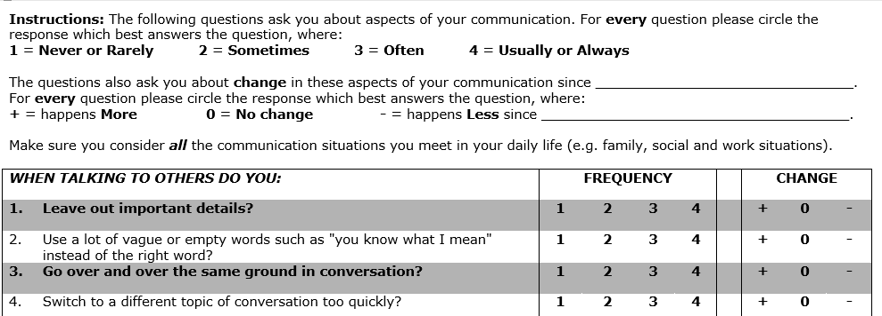
La Trobe Communication Questionnaire (LCQ)

Slide 31
La Trobe Communication Questionnaire (Douglas et al, 2000)
Developed to measure perceived social communication ability from various sources
Most frequently used social communication measure for ABI used by SLPs
Psychometrically evaluated with the TBI population with adequate reliability and validity
Self-rating form and other-rating form
“Change” form can indicate change since injury
Download forms and scoring instructions on InfoCDS > BrICC > Assessment > Social Communication

Slide 32
Performance Based Measures
Performance-based
Social problem solving
Assessment of Interpersonal Problem-Solving Skills (AIPSS)
Video vignettes depict a social problem situation
Functional task-based
Functional Assessment of Verbal Reasoning and Executive Strategies (FAVRES)
Emotion perception tests
E.g. Florida Affect Battery (FAB)
Social cognition tests
The Awareness of Social Inference Test (TASIT)
Video vignettes
Name 7 basic emotions
Interpret sarcasm/sincerity

Slide 33
Context-bound tasks
Observational measure of social disinhibition (Osborne-Crowley, McDonald, & Francis, 2016).
9 open ended questions
Client can choose how much to disclose
Frequency of inappropriate behaviors rated from 1 (never) to 5 (always)
The ‘dice’ game: A new test of pragmatic language skills after closed-head injury (McDonald & Pearce, 1995)
Essential/unnecessary information

Slide 34
Discourse analysis
Exchange Structure Analysis (ESA) (Sim, Power, & Togher, 2013; Bogart, Togher, Power, & Docking, 2012)
Based on Systemic Functional Linguistics
Specifies roles of giving and receiving information
A “move” is a unit of information
An exchange is a series of “moves”
Generic Structure Potential (GSP) analysis (Kilov, Togher, and Grant, 2009)
Modified Conversational Appropriateness (Youse et al, 2011)

Slide 35
Clinician ratings
Behavioral rating scales, checklists
Pragmatic Rating Scales
May be based on a conversation sample or across many interactions
How might these be similar or different from pediatric behavioral rating scales?

Slide 36
Conversation Sampling Considerations
Familiar partner vs. unfamiliar partner or clinician
Context
Communication partner
Relationship, familiarity, age, roles, authority differential, cues, skills)
Task demands (environment, interruptions, predictability, load on working memory, response requirements, stimuli)
May not be a representative sample
Artificialness of the task or testing environment
Increased self-monitoring due to knowing one is being evaluated

Slide 37
Conversation Sampling Tasks
Unstructured conversation (w/ or w/out prompt)
Relationship Closeness Induction Task (RCIT; Sedikides et al., 1999)
Purposeful Conversation Task (Togher et al., 2010)
Joint Problem Solving Task (Kilov et al, 2009)
More info: See https://eatspeakthink.com/wp-content/uploads/2018/12/Assessing-pragmatics-in-adults.pdf

Slide 38
Scoring Conversation Samples
Self-rating
Clinician-rated
Pragmatic rating scales
Impartial other rater/other clinician to increase objectivity
Discourse analysis

Slide 39
Pragmatic Rating Scales
Prutting Pragmatic Protocol (1983)
Behaviorally Referenced Rating System of Intermediate Social Skills (the BRISS) (Flanagan, McDonald, & Togher, 1995)
Adapted Kagan Scales (Togher et al., 2010)
Allows scoring of both person with ABI and Everyday Communication Partner (ECP)
Suited for outcome measure for caregiver training program

Slide 40
Profile of Pragmatic Impairments in Communication (PPIC)
Based on Grice’s maxims
Used in research, rarely in clinical practice
10 feature summary scales (FSS) with 84 specific behavior items
Acceptable interrater reliability for FSS

Slide 41
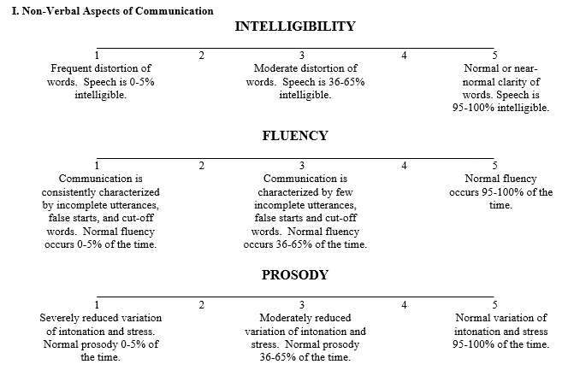
Pragmatics Rating Scale (MacLennan et al., 2002)

Slide 42
Pragmatics Rating Scale (MacLennan et al., 2002)
Ratings from 1-5
Three categories: non-verbal, propositional, and interactional
Strengths:
Simple to learn and score
Quick (mean time to score 1 min, 43 sec) can be simultaneously scored while watching
Acceptable reliability and validity

Slide 43
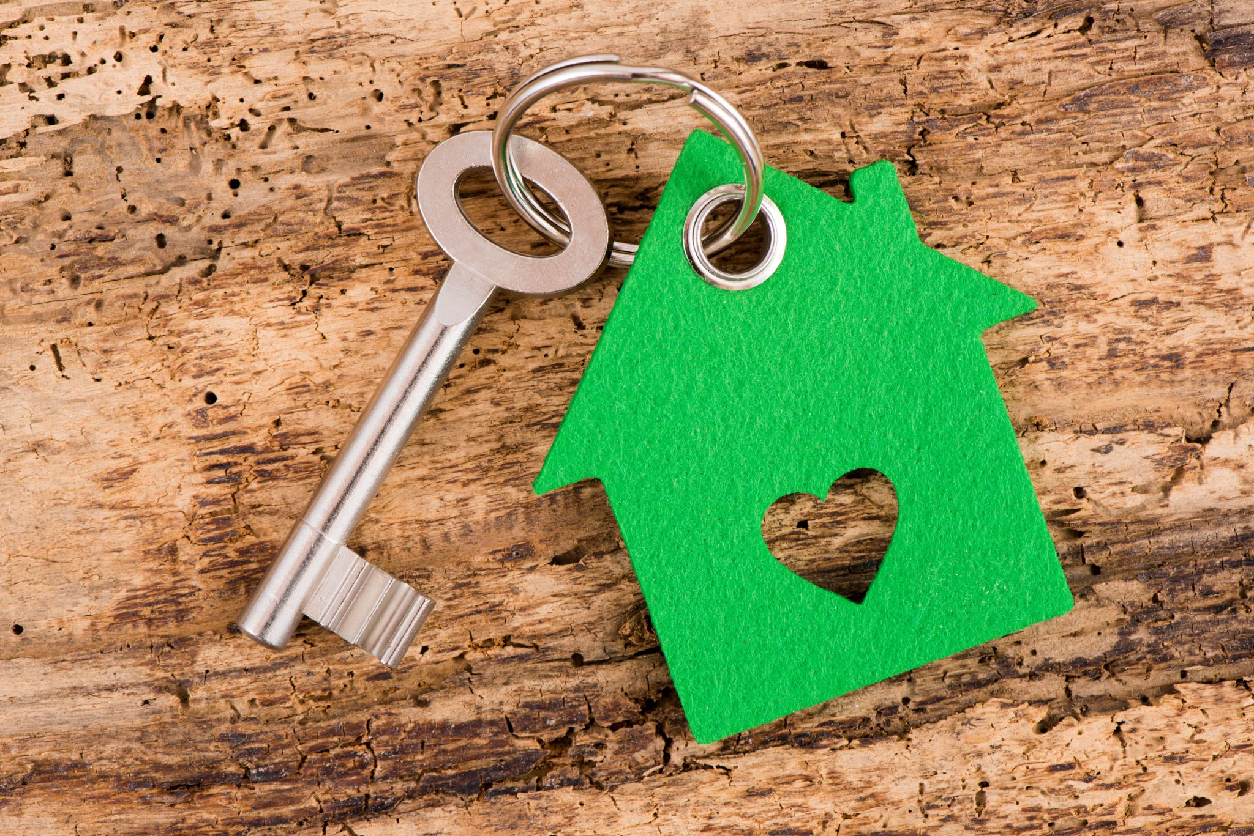
Key Treatment Ingredients

Slide 44
Treatment Ingredients from your Readings?
You read (or are going to read) three articles on this topic:
Ylvisaker (2006) Self-Coaching
Dahlberg (2007) Manualized group treatment
Hoepner & Olsen (2018) Joint Video Self-Modeling

Slide 45

“Self-Coaching” Intervention (Ylvisaker, 2006)
Make self-regulation automatic
Involve the client
Make real-world needs specific
Negotiate scripts and metaphors
Create motivating associations
Self-coaching plays/scripts and communication partner scripts
Practice
Monitoring, revisions, and celebration

Slide 46
Collaborative Approaches
Building Social Networks
Focusing intervention on communication partners
Using Positive Behavioral Supports for difficult social communication behavior

Slide 47
Dahlberg Group Study
12 sessions—manualized group treatment
Co-leaders (SLP and MSW)
Emphasis on self awareness and self-assessment leading to individualized goal setting
Use of group process
Outcome measures PFIC; GAS, CIQ

Slide 48
Interpersonal Recall Training (IPR; Heffenstein, 1979)
Take a 10-15 minute video sample of client with a partner (unstructured)
Reserve 45-50 minutes to review and process the tape with the client, the partner and the clinician (“mutual recall”)
Tape stopped at junctures when there was “deficient skill”
Discussion centered around more adaptive means of interaction

Slide 49
Hoepner & Olsen, 2018
Mixed-methods pilot study
1 person with TBI, one ECP
Joint reflection
Hierarchy of prompts
Open ended to direct

Slide 50
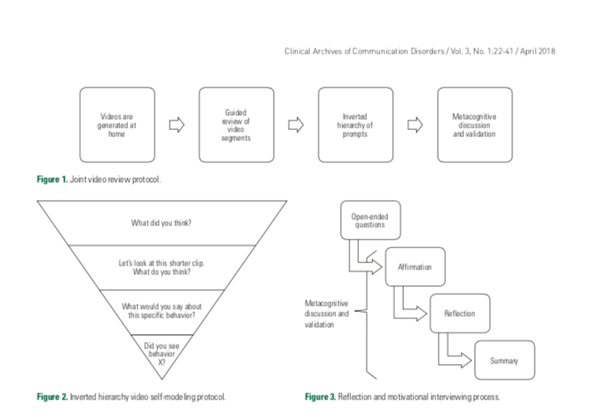

Slide 51
Types of feedback
Direct therapist feedback (verbal)
Videotape feedback
Peer feedback (verbal)
Self ratings
Experiential (natural confrontation, planned success/failure)

Slide 52
Three Relevant Themes
Treatment must be individualized
Little evidence that training discrete social skills generalized to untreated skills and contexts
For highly proceduralized (automatic, routine; behaviors like social skills) change requires many repetitions

Slide 53
Direct Training
Social Skills training (training discrete, isolated skills)
Conversation-specific: “Scripts Training”
Emotional perception training
http://mrl.nyu.edu/~perlin/facedemo/
Social Communication Training
IPR (Heffenstein & Wechsler, 1979)
Group Social Communication Modules (Dahlberg, 2007))
Awareness training (provision of feedback)

Slide 54

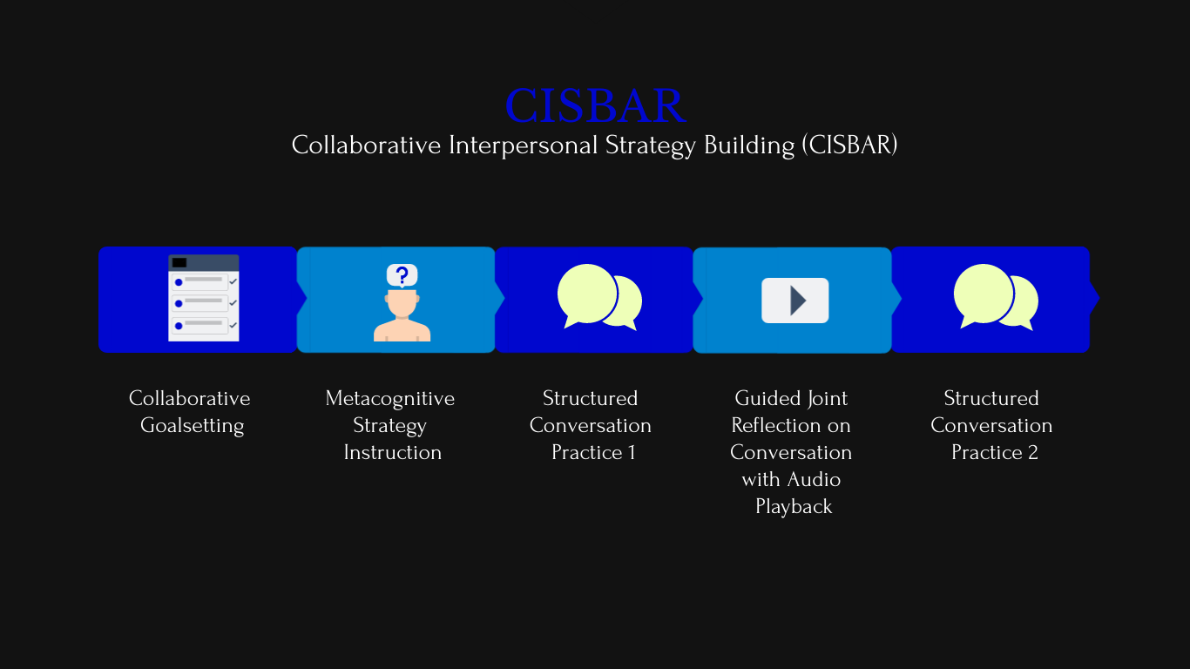
My research intervention
Each intervention session
intake session
1st intervention session
infused throughout

Slide 55
Quick Review
Common issues with social communication
Assessment model
Conversation sampling + rating scales
Key treatment principles
Individualized, contextualized
Involve the participant & ECP
Foster online awareness

